Slide 1
Kidney Stone Detection
Using Image Processing Techniques
GUIDED BY:
Dr. M. SRIDHAR MCA, Ph.D
ASSOCIATE PROFESSOR
PRESENTED BY:
PODILA SAI
L19CA140

Slide 2
Contents
ABSTRACT
PROBLEM STATEMENT
INTRODUCTION
EXISTING SYSTEM
DISADVANTAGES OF EXISTING SYSTEM
PROPOSED SYSTEM
ADVANTAGES OFPROPOSED SYSTEM
SOFTWARE & HARDWARE REQUIREMENTS
APPROACH
RESULTS
CONCLUSION AND FEATURE ENHANCEMENTS

Slide 3
Abstract
Nowadays,kidney stone has become a major problem and if not detected at an early stage then it may cause complications and sometimes surgery is also needed to remove the stone. Kidney stone disease is when a solid piece of material occurs in the urinary tract. The small piece of stone may pass without causing symptoms. If a stone grows to more than 5 millimeters it can cause blockage of the ureter resulting in severe pain in the lower back or Abdomen. Hence it's necessary to have an approach to detect the stone in the kidney to avoid further health issues. Generally we use ultrasound technique to find the stones in kidney. But, the image produced by the ultrasound techniques is not suitable for further processing due to low contrast and the presence of speckle noise. Hence, the study also examined the effectiveness of various de-noising techniques on the ultrasound image to enhance the quality of the image. Further, the enhanced ultrasound image is used to locate the exact position of the stone.
Notes:
Generally we use ultrasound technique to find the stones in kidney. But, the image produced by the ultrasound techniques is not suitable for further processing due to low contrast and the presence of speckle noise.

Slide 4
Problem Statement
The kidney malfunctioning can be life intimidating. Hence early detection of kidney stone is essential. Precise identification of kidney stone is vital in order to ensure surgical operations success. The ultrasound images of kidney comprise speckle noise and are of low contrast which makes the identification of kidney abnormalities a difficult task. As a result, the doctors may find identification of small stones and the type is difficult and challenging for identify the small kidney stones and their type appropriately. To address this issue, a reaction diffusion level set segmentation is proposed to identify location of the stone;The main motive of this project was to develop an elementary and straightforward technique to find the stone in the kidney. This detection can be done in any available PC’s and hence any normal being can check an ultrasound for a kidney stone and dissolve it in the starting stage. These techniques mainly help the doctor to further treat the patient based on the size and location of the stone.

Slide 5
Introduction
Kidney stone disease is one of the major life threatening ailments persisting worldwide. The stone diseases remain unnoticed in the initial stage, which in turn damages the kidney as they develop. A majority of people are affected by kidney failure due to diabetes, hypertension and so forth. diagnosis of the problem in the initial stages is advisable. Ultrasound (US) image is one of the currently available methods with non-invasive low cost and widely used imaging techniques for analyzing kidney diseases.
Rahman and Uddin have proposed diminution of speckle noise and segmentation from US image. It not only detects problem in the kidney region but also provides image quality enhancement. Hence, the study also examined the effectiveness of various de-noising techniques on the ultrasound image to enhance the quality of the image. Further, the enhanced ultrasound image is used to locate the exact position of the stone.

Slide 6
Existing System
CT Scan:
A computed tomography (CT or CAT) scan allows doctors to see inside your body. It uses a combination of X-rays and a computer to create pictures of your organs, bones, and other tissues. It shows more detail than a regular X-ray.
You can get a CT scan on any part of your body. The procedure doesn't take very long, and it's painless.They use a narrow X-ray beam that circles around one part of your body. This provides a series of images from many different angles. A computer uses this information to create a cross-sectional picture. Like one piece in a loaf of bread, this two-dimensional (2D) scan shows a “slice” of the inside of your body.

Slide 7
Ultrasound:
A type of imaging test to examine the internal organs using very high frequency sound waves.Ultrasound (US) images have recently become more widespread because of their better quality and portability for medical applications. Ultrasound is mostly preferred for initial medical monitoring, diagnosis, and follow-up in comparison to other medical image modalities for its low cost. Because of its benefits, it is broadly utilized for the diagnosis of various diseases in the liver, breast, prostate, and thyroid.
Ultrasound is safe and effective when used to detect and remove the stones without exposing patients and operating room staff to radiation.

Slide 8
Disadvantages of existing system
CT Scan:
Cost effective and not feasible.
High doses of radiation are involved in CT scanning - chest CT scan is equivalent to 350 chest X-rays; CT abdomen to 400 chest X-ray.
Ultrasound:
It has poor penetration through bone or air. Moreover it has limited penetration in obese patients. These are the disadvantages in imaging domain
the image produced by the ultrasound techniques is not suitable for identifying small stones due to low contrast and the presence of speckle noise.

Slide 9
Proposed system
Performing various de-noising techniques on the ultrasound image to enhance the quality of the image. Further, the enhanced ultrasound image is used to locate the exact position of the stones and also marking the stones. This detection can be done in any available PC’s and hence any normal being can check an ultrasound for a kidney stone and dissolve it in the starting stage. These techniques mainly help the doctor to further treat the patient based on the size and location of the stone.

Slide 10
Advantages of proposed system
Cost saving
Efficient when compared to existing systems
We can find out the exact position of the stones and also marking the stones.
This detection can be done in any available PC’s and hence any normal being can check an ultrasound for a kidney stone

Slide 11
‌SOFTWARE & HARDWARE REQUIREMENTS
‌Software requirements specification: Operating System : Windows 7 or above Python IDE : Python 3.7 or above Jupyter Notebook, Anaconda 3.5 or above
Hardware requirements specification: Processor : Intel i3 or above HARDDISK : 500 GB minimum RAM : >4 GB

Slide 12
APPROACH
To detect the kidney stone, we used the following approach:
The kidney stone produces an acoustic shadow in the ultrasound image. An acoustic shadow or sound shadow is an area through which the sound waves fail to propagate due to topographical obstructions. In this case, the kidney stone is the barrier that disrupts the sound waves. Once we detect the shadow, the stone can be located.
The ultrasound images contain speckle noise.To process the image and detect the location of the stone in the image, we need to remove the noise. Thus, the first step is to enhance the image by using various sharpening and smoothing filters.
After the image is enhanced, image segmentation is used to differentiate between the shadow and the stone by separating the foreground and the background

Slide 13
We will use the following various sharpening and smoothing filters:
Gaussian Filter :
A Gaussian filter is a linear filter. It's usually used to blur the image or to reduce noise. If you use two of them and subtract, you can use them for "unsharp masking" (edge detection). The Gaussian filter alone will blur edges and reduce contrast.
Median Blur :
In general median filter may be used for filtering different types of noise but it is the best choice for images corrupted by 'salt and pepper' noise. This is not common type of noise. It appears when a CCD matrix pixel is corrupted or when the data transmission is unstable. A situation of that kind occurs on the satellite imagery (data transmission errors) or MRI scans.Median filter works very well with the salt and pepper noise

Slide 14
Gaussian Blur :
a Gaussian blur (also known as Gaussian smoothing) is the result of blurring an image by a Gaussian function (named after mathematician and scientist Carl Friedrich Gauss). It is a widely used effect in graphics software, typically to reduce image noise and reduce detail. The visual effect of this blurring technique is a smooth blur resembling that of viewing the image through a translucent screen, distinctly different from the bokeh effect produced by an out-of-focus lens or the shadow of an object under usual illumination.
Laplacian filter :
The Laplacian filter is an edge-sharpening filter, which sharpens the edges of the image.
Gabor filter:
In image processing, a Gabor filter, named after Dennis Gabor, is a linear filter used for texture analysis, which essentially means that it analyzes whether there is any specific frequency content in the image in specific directions in a localized region around the point or region of analysis.

Slide 15
The first step was to get a clear and better quality of the data so we worked on the IMAGE ENHANCEMENT:
1. The first one we applied was Frequency Domain + Gaussian Filter. Here we had to divide the image into two plains real plain and complex plain and then apply the Gaussian Filter in both.
2. The second attempt was with Gaussian Blur + Laplacian Filter. We had to apply Gaussian Blur to make Laplacian filter less sensitive to noise.
3. On further studies, we found in some research papers (link given below) that Ultrasounds give speckle noise. So, our third attempt was to replace Gaussian Blur with Median Blur as the latter is more effective for low-level noises like speckle noise, salt-and-pepper noise etc. followed by Laplacian filter.
4. In the application of the Gabor filter, the restored image is enriched with optimal resolution in both spatial and frequency domains (as stated in one of the research papers,whose link is given below). 2-D Gabor filter is easier to tune the direction and radial frequency bandwidth, and easier to tune center frequency, so they can simultaneously get the best resolution in the spatial domain and frequency domain.

Slide 16
Now we moved to our next step HISTOGRAM EQUALIZATION.
It is a technique for adjusting image intensities to enhance contrast. It assigns the intensity values of pixels in the input image such that the output image contains a uniform distribution of intensities. It improves contrast and obtains a uniform histogram. This technique can be used on a whole image or just on a part of an image. This process leads to an increase in contrast of the shadow of the stone and the stone itself. Thus, it became more visible.

Slide 17
Histogram Equalization Algorithm
Histogram Equalization aims to enhance the contrast of an image by stretching out the most frequently used intensity values. It’s objective is to increase contrast in areas where it’s low resulting in an image that displays an increased number of darker and lighter areas.
The histogram equalization algorithm can be broken up into four main parts:
Creating the histogram
Calculating the histograms cumulative sum
Making a mapping from old colours to new ones
Applying the mapping to create our new image
Creating the Histogram
The first step is to create a histogram that records the number of pixels at each intensity level, we do this for two reasons:
It allows us to see how good/bad the colour range of an image is
We use this histogram to calculate our mapping in the next couple of stages

Slide 18
Calculating Cumulative Sum
The next step is to calculate the cumulative sum (a.k.a running total) of our histogram. This is important for the next stage as it’s used in our mapping calculation; luckily for us, it’s easy to calculate! Let’s look at the Python code:
def make_cumsum(histogram):
""" Create an array that represents the cumulative sum of the histogram """
cumsum = np.zeros(256, dtype=int)
cumsum[0] = histogram[0]
for i in range(1, histogram.size):
cumsum[i] = cumsum[i-1] + histogram[i]
return cumsum

Slide 19
Create a Mapping
Now for the fun part, let’s make our mapping! The mapping is created from the following formula:
M(i)=max(0,round((grey_levels∗cumsum(i))/(h∗w))−1)
where:
i = 0 … grey_levels
grey_levels = number of grey levels in our image (usually 256)
cumsum(i) = i’th element of the array produced by our make_cumsum(histogram) function
h, w = the height and width of our image
Apply the Mapping
Time to create our new image, to do this we simply apply the mapping we made in the last step:
new_image[i] = mapping[img[i]]
The output of this function is an array containing the pixel values of the new, histogram equalized image

Slide 20
After this, we proceeded towards IMAGE SEGMENTATION.
It partitions an image into distinct regions containing each pixel with similar attributes. To be meaningful and useful for image analysis and interpretation,the regions should strongly relate to depicted objects or features of interest.Meaningful segmentation is the first step from low-level image processing transforming a grayscale or color image into one or more other images to high-level image description in terms of features, objects, and scenes. Hereby performing this, we needed to partition our stone from the rest of the image.The type of Image Segmentation used here is Watersheds.

Slide 21
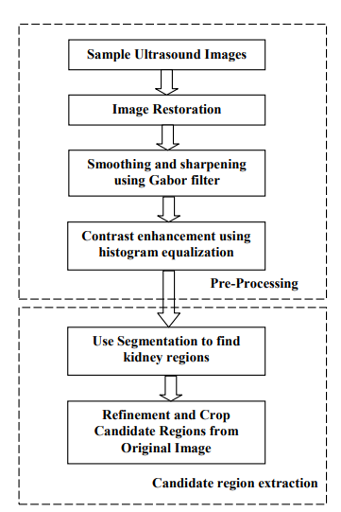
Block diagram of kidney segmentation system:

Slide 22
Watersheds:
Here we divide the image into peaks (high intensity) and valleys (low intensity). We fill the valleys (points of minima or background) with water of different colors (labels). As the water rises, depending on the peaks(gradients) nearby, water from different valleys, obviously with different colors will start to merge. To avoid this, we need to build barriers in the area where the water is mixing. Also, we continue the process of filling water until all the peaks are under water. The barriers, thus, created are the result of image segmentation. Now, the shadow gets separated from the stone giving a clear image of the stone.

Slide 23
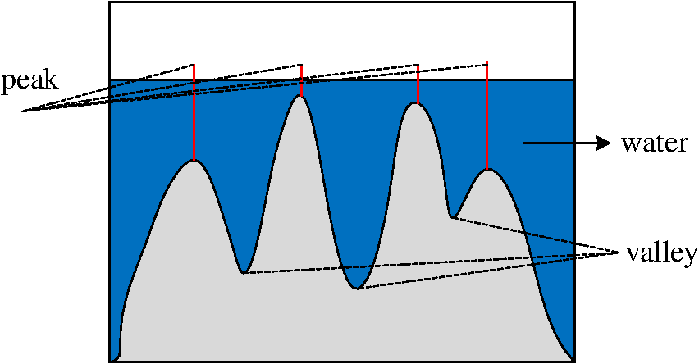

Slide 24
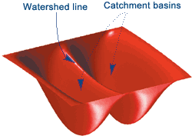
Basic concept of watershed algorithm is to find the watershed lines.
•We flood this surface from its minima
•And we prevent the merging of the waters coming from different sources.
• We partition the image into two different sets: the catchment basins and the watershed lines.
Steps in Watershed Algorithm:
Read in an Image and covert it in grayscale
Use the gradient magnitude as the segmentation function
Mark the foreground objects
Compute the Background markers
Compute the watershed transform of the segmentation function
Visualize the result.

Slide 25
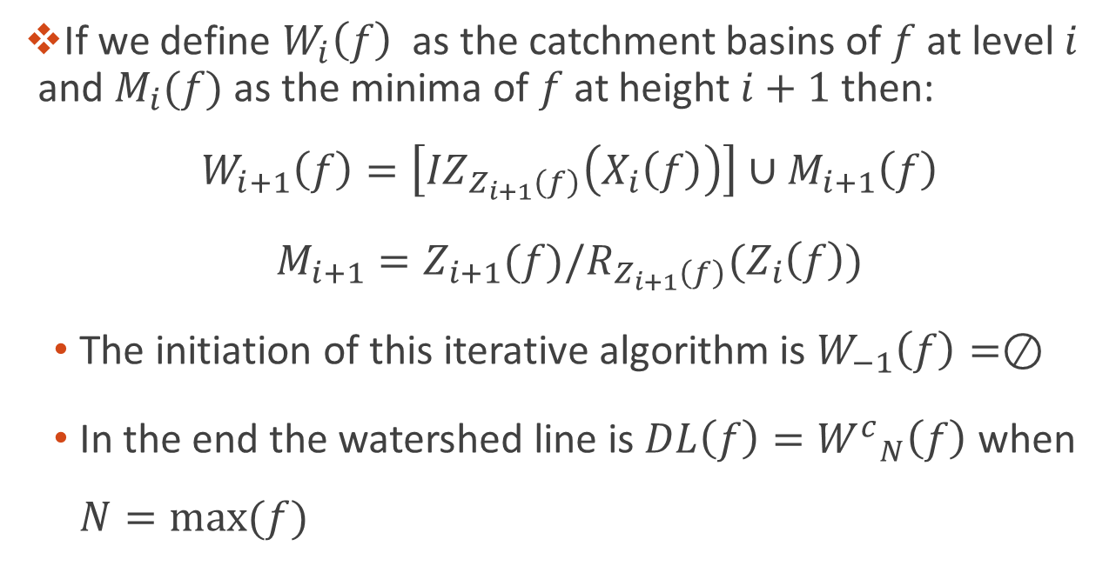
BUILDING THE WATERSHED

Slide 26
The last step being MARKING:
It provides you with a way to identify or label a spot within the processing pipeline. Adding a marker into the pipeline will allow you to refer to the image currently being processed at that point. It can also be used to specify a location in the pipeline for other modules.

Slide 27
RESULTS
Total of 4 approaches have been performed to enhance the quality of the image, namely: Gabor Filter, Median blur + Laplacian Filter, Gaussian blur + Laplacian Filter, Gaussian Filtering in Frequency domain. Out of the 4, we have noticed that Gabor Filter was effective on a larger number of images though not all. Nextly Median blur + Laplacian Filter and Gaussian blur + Laplacian Filter worked perfectly with other of the few images which are lesser compared to Gabor Filter. Lastly, Gaussian Filtering in Frequency domain, which didn’t work as expected and hence this technique was not employed to enhance any of the other images. We also could generalize the effectiveness of the techniques due to lack of data samples.

Slide 28
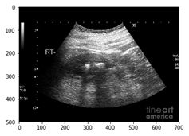
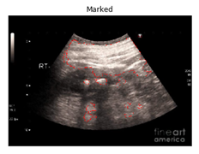
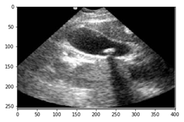
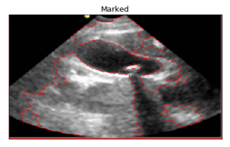
Resulting images of ultrasound are given below:
Original image Image with Detection

Slide 29
DISCUSSION
The effectiveness of various enhancement techniques:
Out of the 4 approaches, we conclude that Gabor filter is more effective because it is a linear filter used for texture analysis, which means that it basically analyzes whether there is any specific frequency content in the image in specific directions in a localized region around the point or region of analysis.Hence due to this, to locate a stone (i.e. we have to locate a region above the shadow formed by the stone)Gabor filter works more efficiently. Whereas in the case of median blur followed by Laplacian filter, it’s a nonlinear digital filtering technique,often used to remove noise from an image or signal with retaining the edges.Hence it’s an effective procedure when there are particulate noises such as salt and pepper. Nextly Gaussian blur followed by Laplacian filter is used to typically to reduce image noise and reduce detail. As details are also lost hence this technique doesn’t give a clear image so it’s followed by a Laplacian filter to increase the edges. Lastly, Gaussian in frequency domain failed because the real and imaginary plane was not separated and hence the inverse transformation did not take place properly.

Slide 30
Test Case
S .No | Test case Description | Actual value | Expected value | Result
1 | Load image | Load only kidney stone image produced by ultrasound scanning | Load kidney stone image. | True
2 | Performing Histogram Equalization Algorithm | aims to enhance the contrast of an image | Better quality of image must be produced | True
3 | Performing watershed | find the watershed lines | watershed line shows successfully | True
4 | Marking | Marking stones | Display stones with marking successfully | True

Slide 31
-VE Test Case
S .No | Test case Description | Actual value | Expected value | Result
1 | Load Image | If uv image is not uploaded | Load image | False
2 | Sharpening filtering | Image is not enhanced | Image is not enhanced | false

Slide 32
Conclusion and feature Enhancements
We had an image of an ultrasound of a kidney containing a stone. We applied the Gabor Filter for the Image Enhancement followed by Histogram Equalization. The restored image went under Image Segmentation, namely, Watersheds after which Marking was done and the final image was produced. The final image showed a distinct location of the stone in the kidney. Hence the stone was detected. In the future work, the system will be designed for real time implementation by placing biomedical sensors in the abdomen region to capture kidney portion. The captured kidney image is subjected to the proposed algorithm to process and detect stone on FPGA using hardware description language (HDL). The identified kidney stone in the image is displayed with colour for easy identification and visibility of stone in monitor.

Slide 33
Thank
You
Any ?

